Slide 1


Generative AI Opportunities and Challenges
v
Mr. Bhavya Shah

Slide 2


Education: Completed MCA in 2018.
Experience:
Govt. of Gujarat (Education Department):
3+ years of experience.
Key Projects:
NAMO eTAB App: Digital Education.
Mobile Attendance System:
COGENT: Education ERP system.
Oracle ERP (JDE and Fusion):
3+ years of experience.
Focus: Localization and Manufacturing (MFG).
Specialized in ERP solutions and integrations.
About My Self

Slide 3
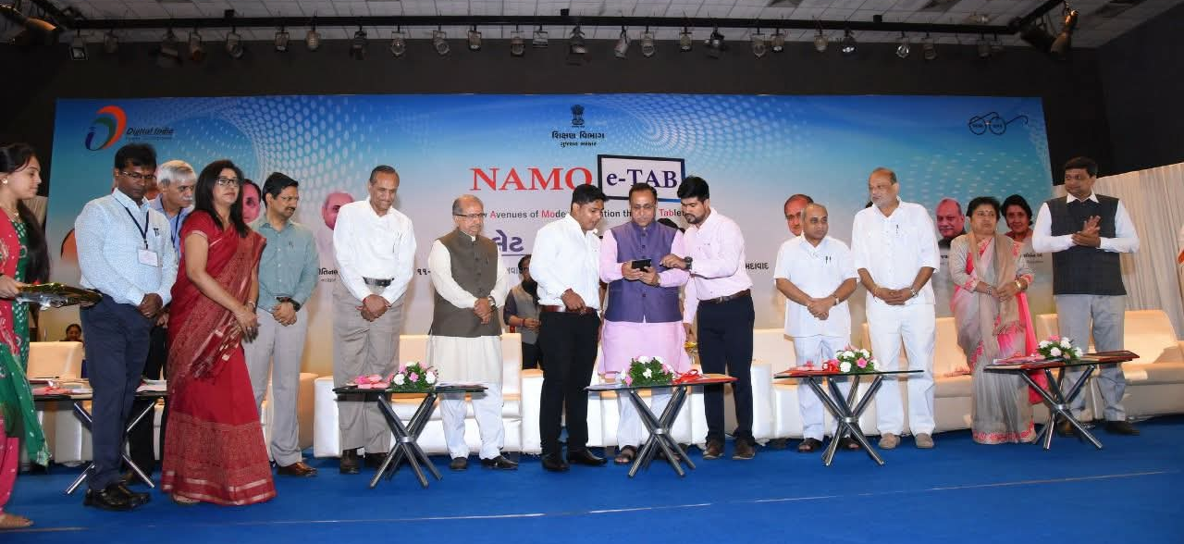
NAMO e-TAB App was launched by - Late CM Shri Vijaybhai Rupani

Slide 4
Today’s Agenda

Slide 5
What is Artificial Intelligence?
Ability of machines to mimic the abilities and problem-solving capabilities of human intelligence.
What is Human Intelligence ?
► Learn new skills through observation
► Thinks abstractly and Plans short and long term
► Communicates using a language and gesture
► Handles complex situations in real time
► Creates art, music and inventions

Slide 6
What is Artificial Intelligence?
If you can replicate any of these capabilities of Human Intelligence in machines, that is Artificial General Intelligence (AGI)
When we apply AGI to solve problems/Objective, then we call it as -Artificial Intelligence (AI)

Slide 7
AI Use cases

Slide 8
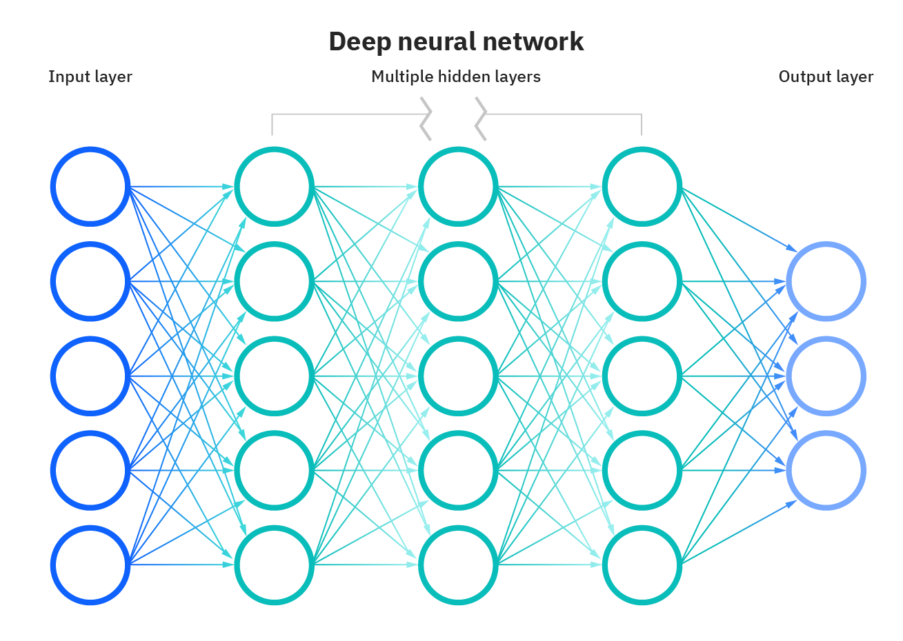
What is Relationship Between AI and Generative AI

Slide 9
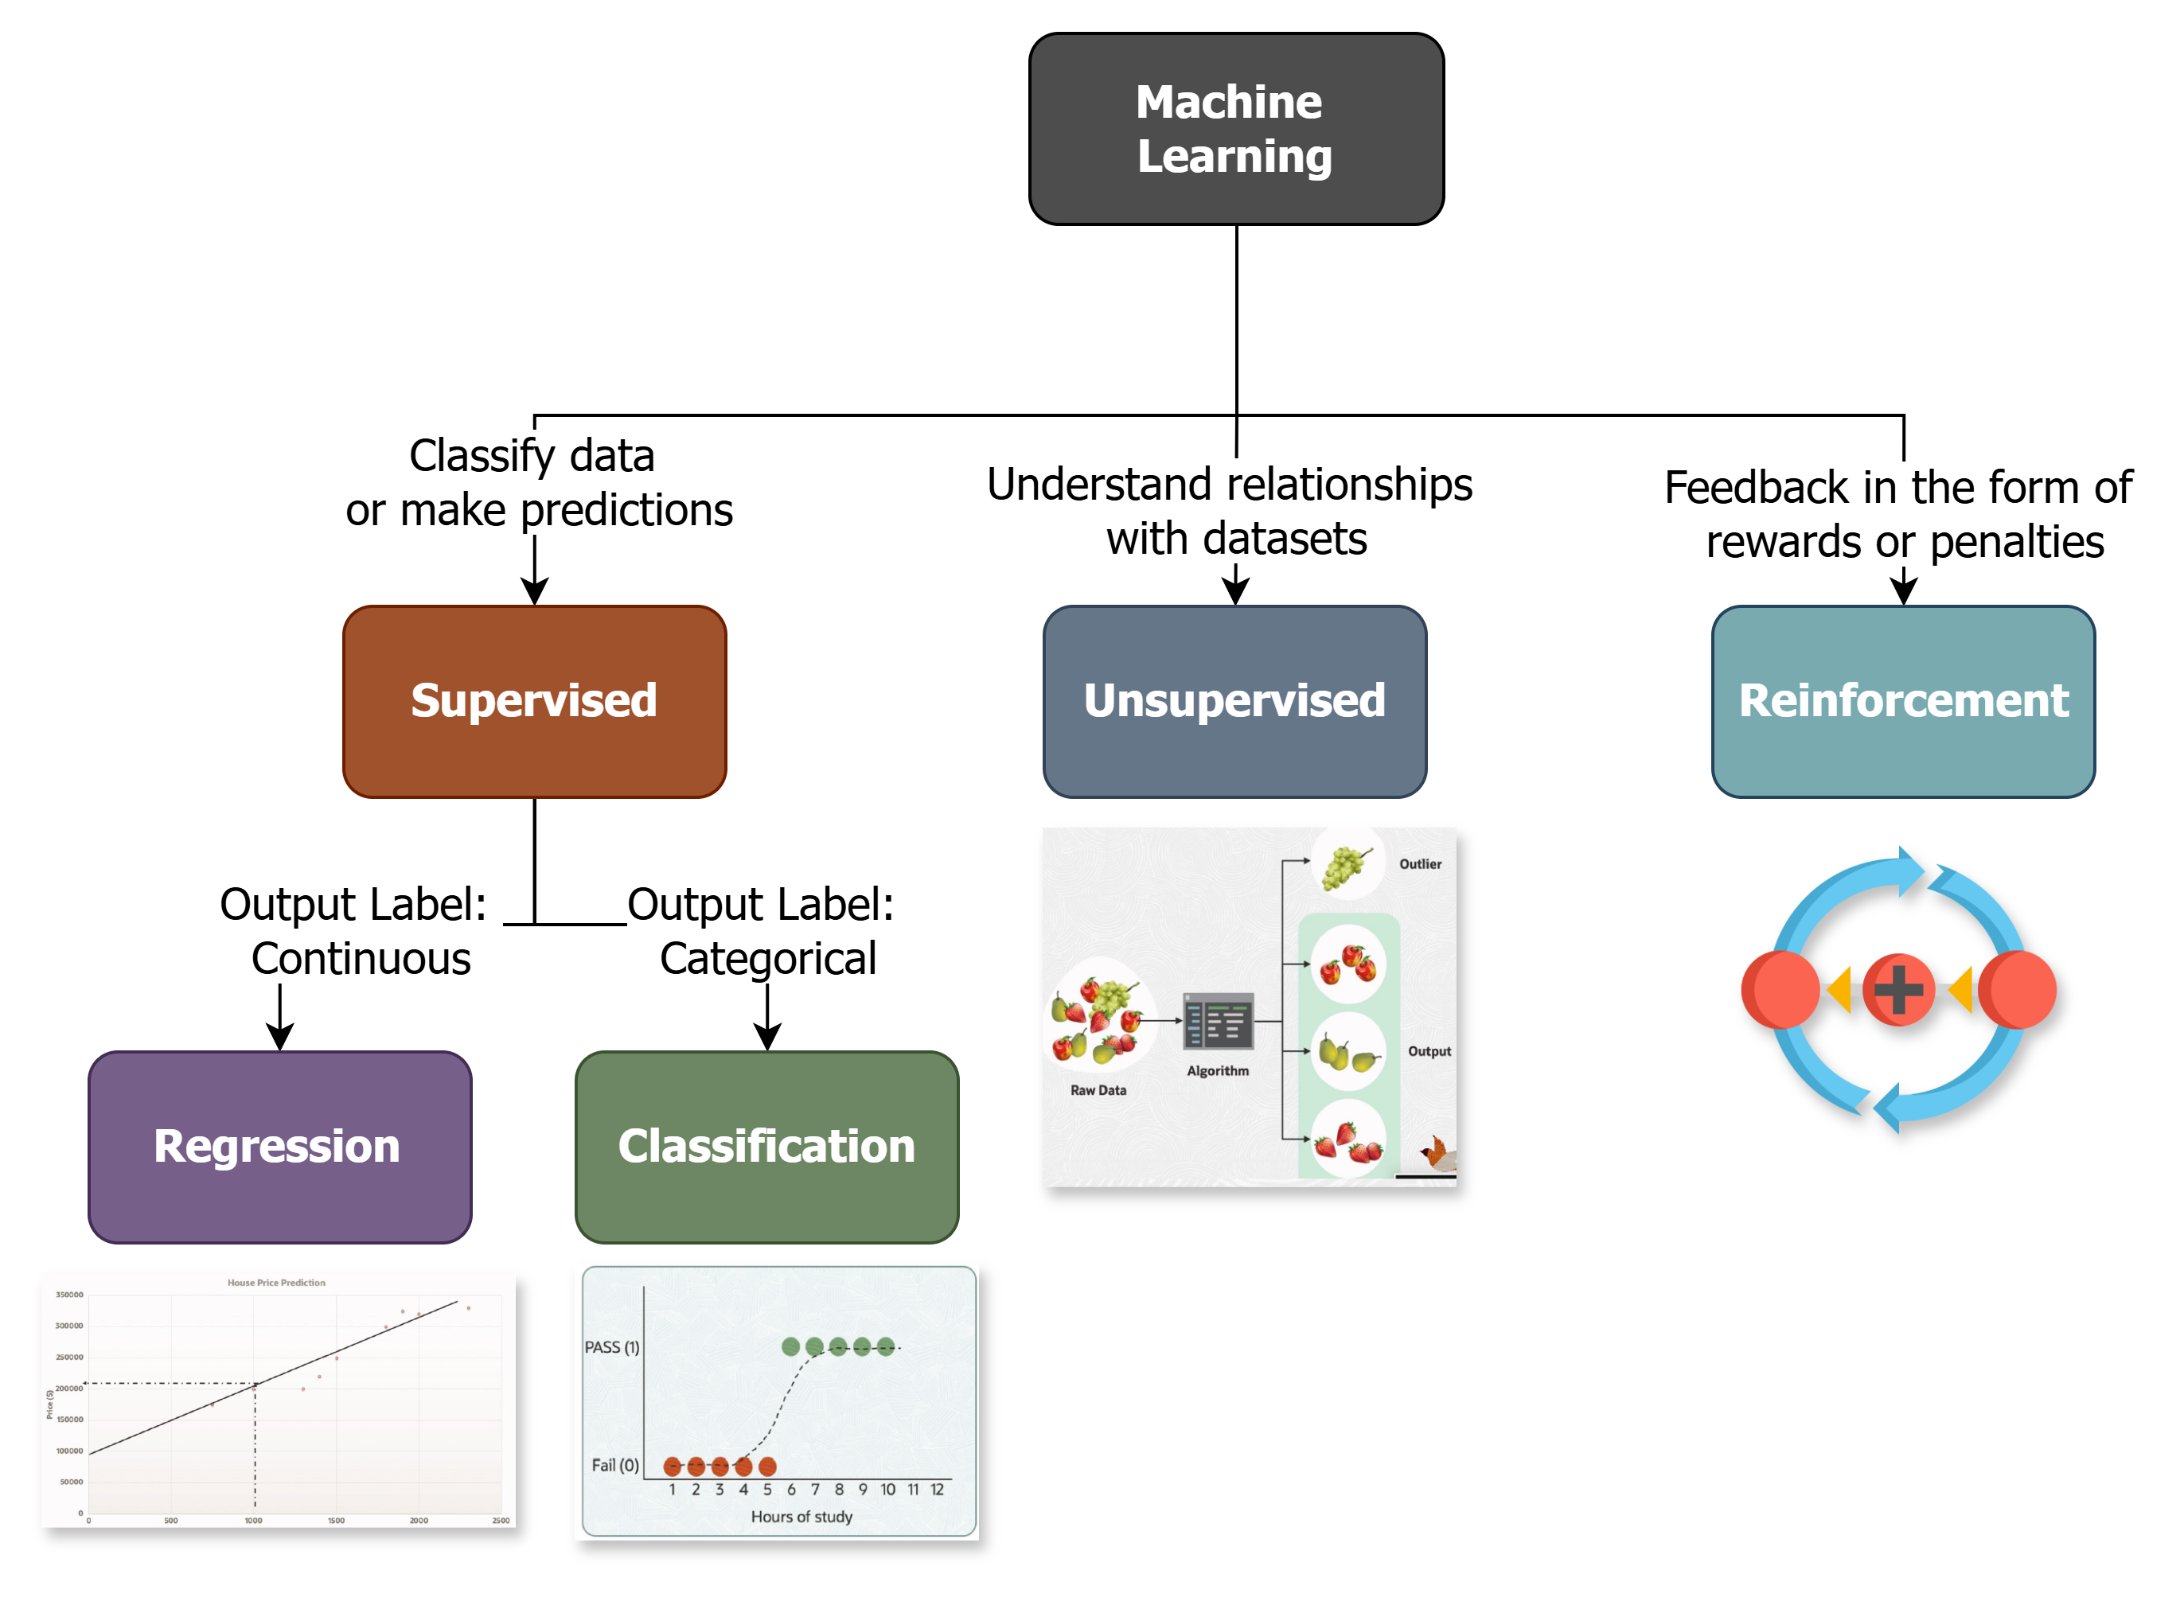
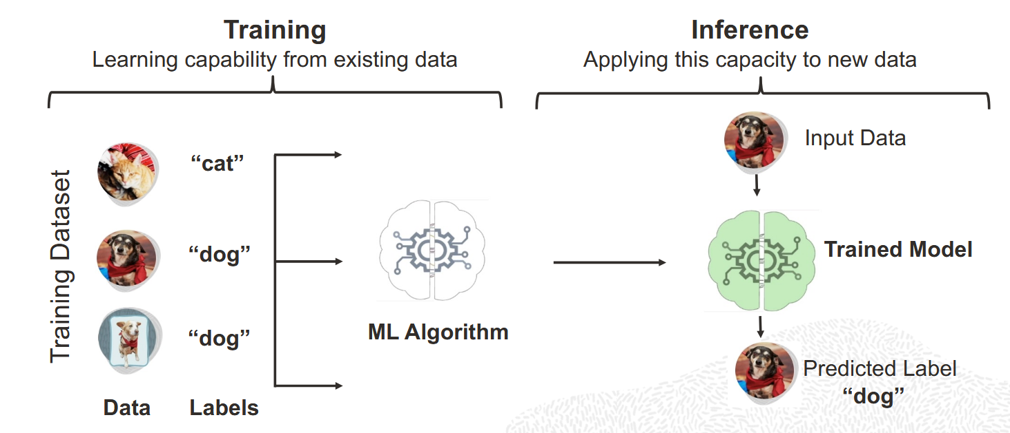

Slide 10
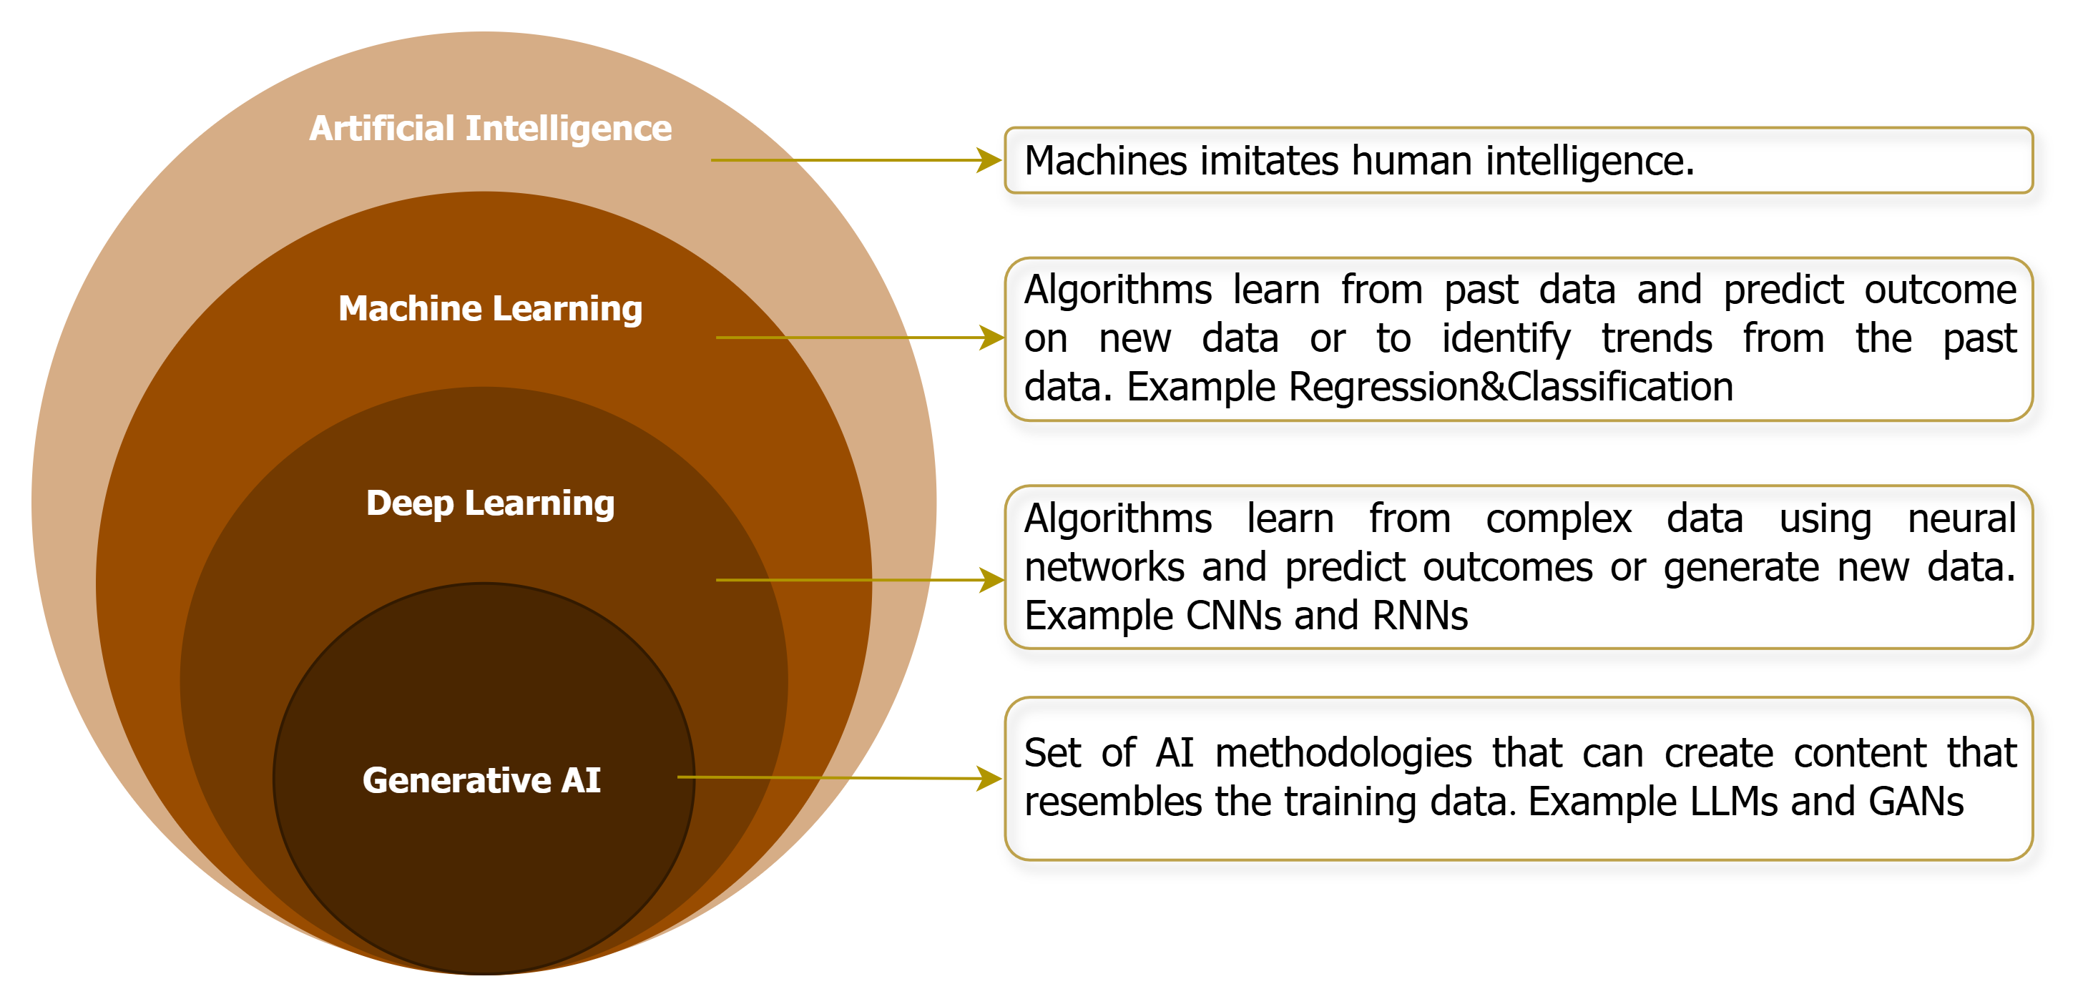


What is Generative AI
GenAI?
Models that can create/generate a wide range of outputs such as images, music, speech, text and other types of data.
It uses techniques like Generative Adversarial Networks (GANs) or LLM using Transformer-based models (e.g., GPT) - Understand, generate and process human language at a massive scale
Learns the patterns in a data set and uses that knowledge to create new data

Slide 11
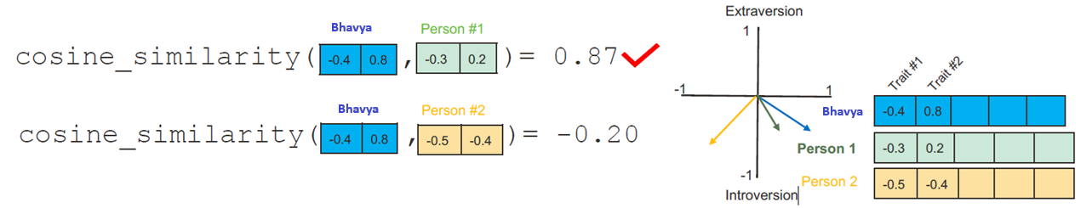
How Data Representation and Process in Large Date set?
How?
Take Example
On a scale of 0 to 100, how introverted/extraverted are you?
Big Five Personality Test. These tests ask you a list of questions, then give you score.
Imagine I’ve scored 38/100 as my introversion/extraversion score - Now I have to find similar person
Vactor
[ 0.50451 , 0.68607 , -0.59517 , -0.022801, 0.60046 , -0.13498 , -0.08813 , 0.47377 , -0.61798 , -0.31012 , -0.076666, 1.493 , - 0.034189, -0.98173 , 0.68229 , 0.81722 , -0.51874 , -0.31503 , -0.55809 , 0.66421 , 0.1961 , -0.13495 , -0.11476 , -0.30344 , 0.41177 , -2.223 , -1.0756 , -1.0783 , -0.34354 , 0.33505 , 1.9927 , -0.04234 , -0.64319 , 0.71125 , 0.49159 , 0.16754 , 0.34344 , -0.25663 , - 0.8523 , 0.1661 , 0.40102 , 1.1685 , -1.0137 , -0.21585 , -0.15155 , 0.78321 , -0.91241 , -1.6106 , -0.64426 , -0.51042 ]

Slide 12
How GenAI generate content ?
Tokens : Language models understand “token” rather than characters. One token can be a part of a word, an entire word, or punctuation.
Many words map to one token, but some don’t: indivisible.
Temperature : Temperature is a parameter that controls the randomness of the LLM output. Example : The sky is ________

Slide 13
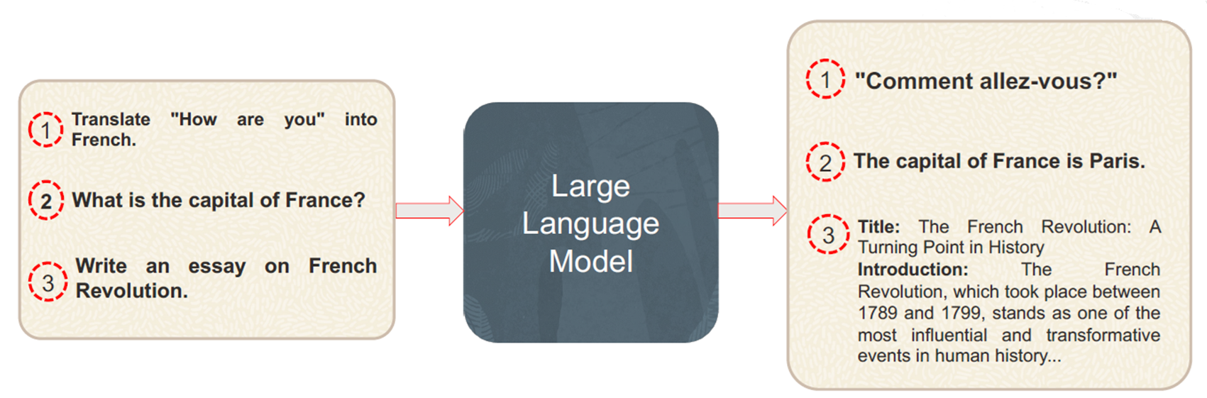
Large Language Models (LLMs)
Understand, Generate and Process human language at massive scale. Designed for sequence-to-sequence tasks such as machine translation
Generate text based on Deep Learning architectures like Transformers Trained on vast language data to recognize patterns.
Scaled to hundreds of millions to billions of parameters to enhanced contextual understanding using Natural language understanding and processing tasks.

Slide 14
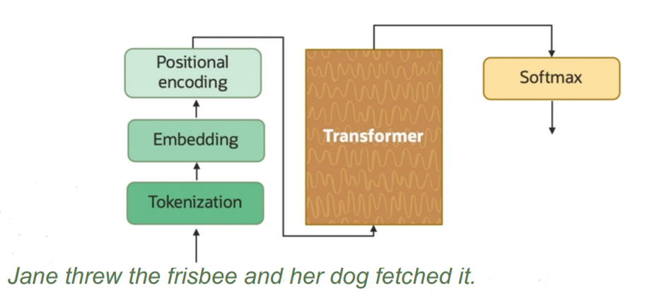
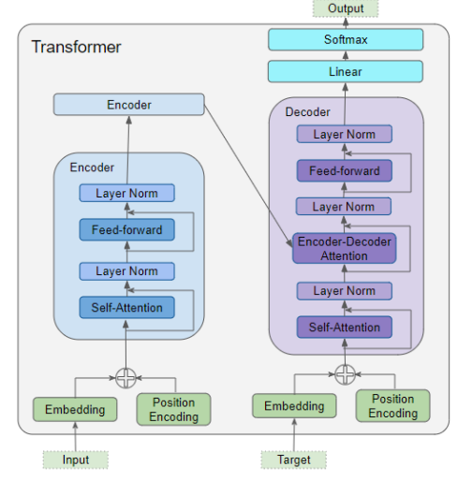
Transformers Architecture
The Sentence is broken down into smaller pieces called tokens.
Each token is then converted into a numerical form (a vector) that the model can understand.
The Position Encoding layer represents the position of the word.
The Encoder & Decoder stack contains a number of Encoders and Decoders. Each Encoder and Decoders contains Multi-Head Attention layer and Feed-forward layer.
Attention: Helps understand the context of each word.
Feedforward: Applies a specific function to each word individually
The model generates a list of scores for each word in the vocabulary. The model uses the Softmax function to turn these scores into probabilities.

Slide 15
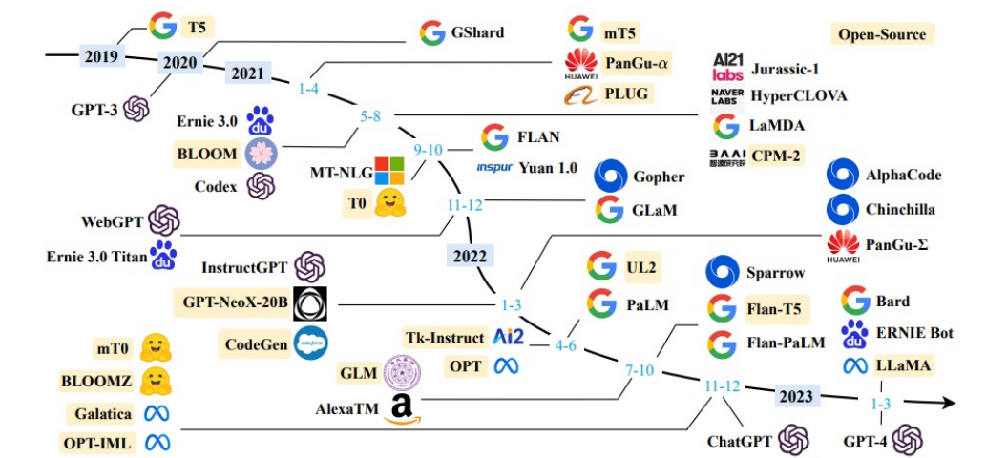
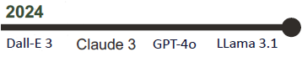
History of LLM
1950s - Alan Turing proposed Turing Test
1980s-1990s Statistical language models emerged

Slide 16
What is Mechanics of Image Generation
https://www.christies.com/lot/lot-edmond-de-belamy-from-la-famille-de-6166184/
Generate realistic images that
resemble training data. $432K

Slide 17
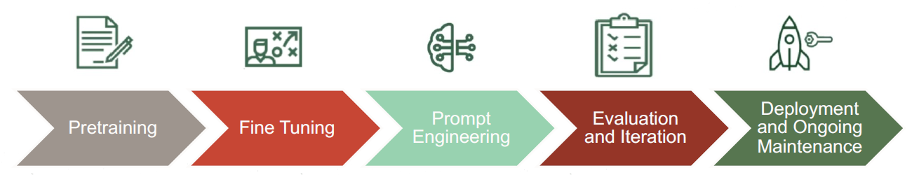
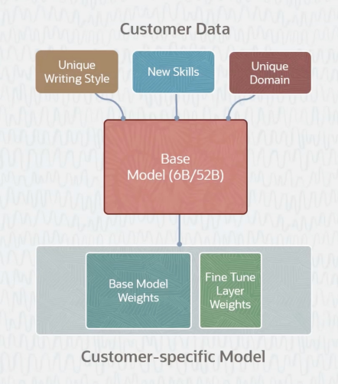
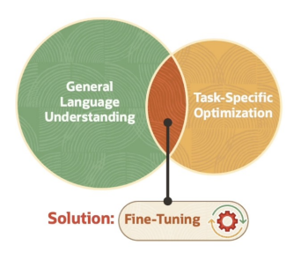
LLM Lifecycle & Fine Tuning

Slide 18
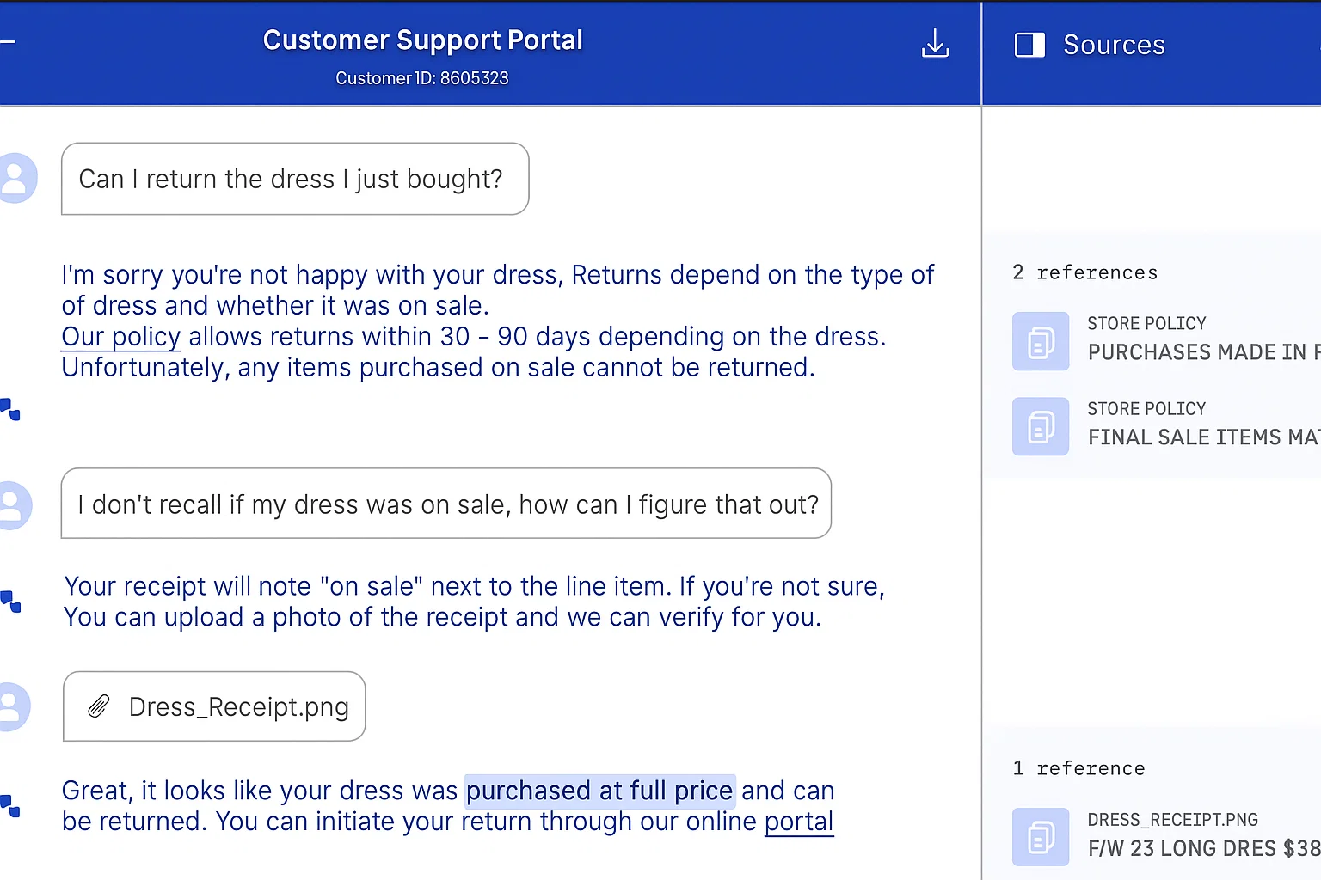

Retrieval Augmented Generation (RAG)
RAG is a method for generating text using additional information fetched from an external data source.
RAG models retrieve documents and pass them to a seq2seq model.
RAG do not require custom Models.
Retriever
Augmented
Generator
Sources relevant information from a large corpus or database.
Evaluates and prioritizes the information retrieved by the Retriever.
Generates human-like text
based on the retrieved and ranked information with the user’s original queries.

Slide 19
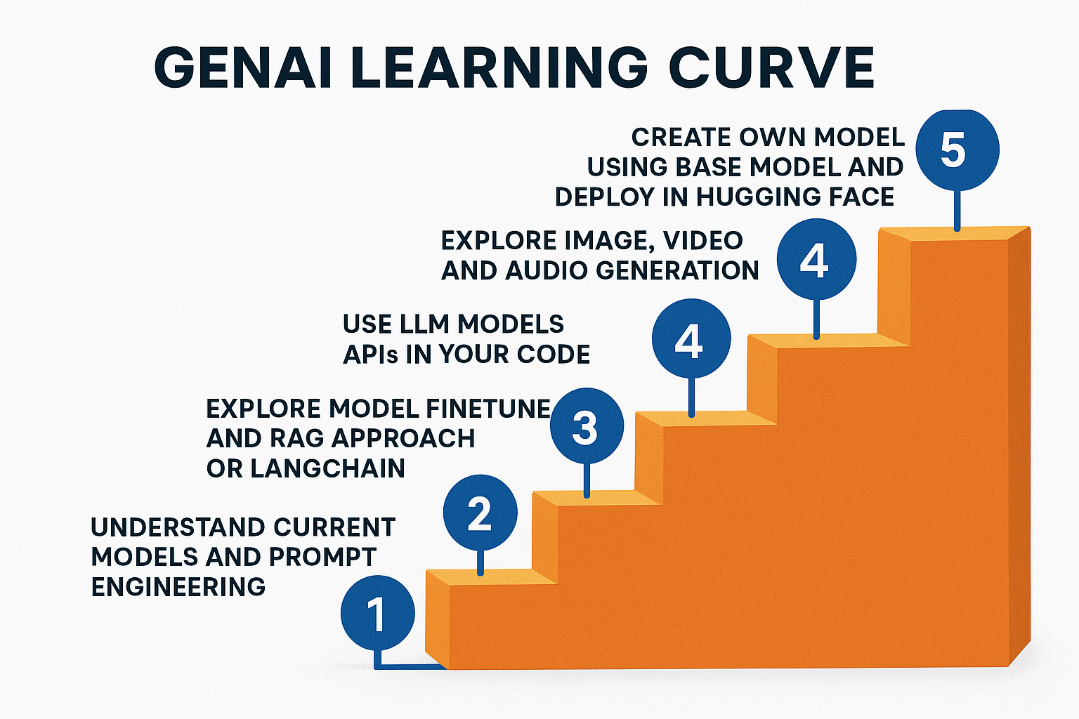

Slide 20
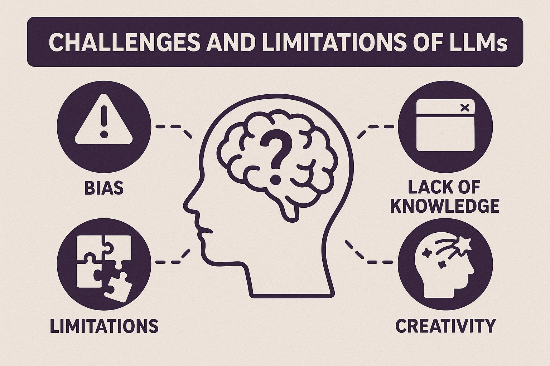

Slide 21


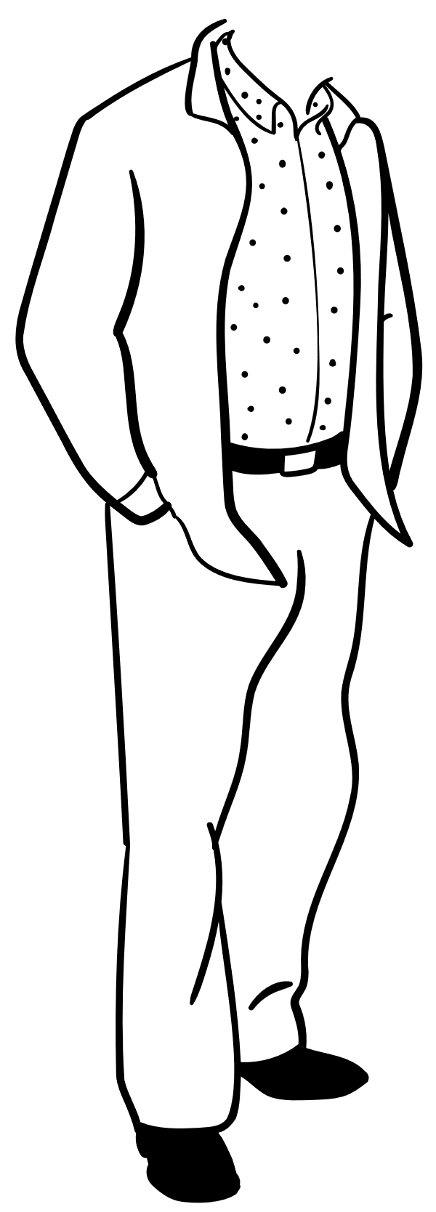

Question & Answer

Slide 22
Thank You…
Bhavya Shah
SHAHBHAVYA5800@GMAIL.COM

